Slide 1
Client-Server Communication

Slide 2
Objectives
Introduction to Client-Server Architecture
Architecture of ReactJS Applications
Client-Server Communication Methods
Message Formats in Client-Server Communication
Set up a simple server that makes data available for clients
Access the data from the server using a browser

Slide 3
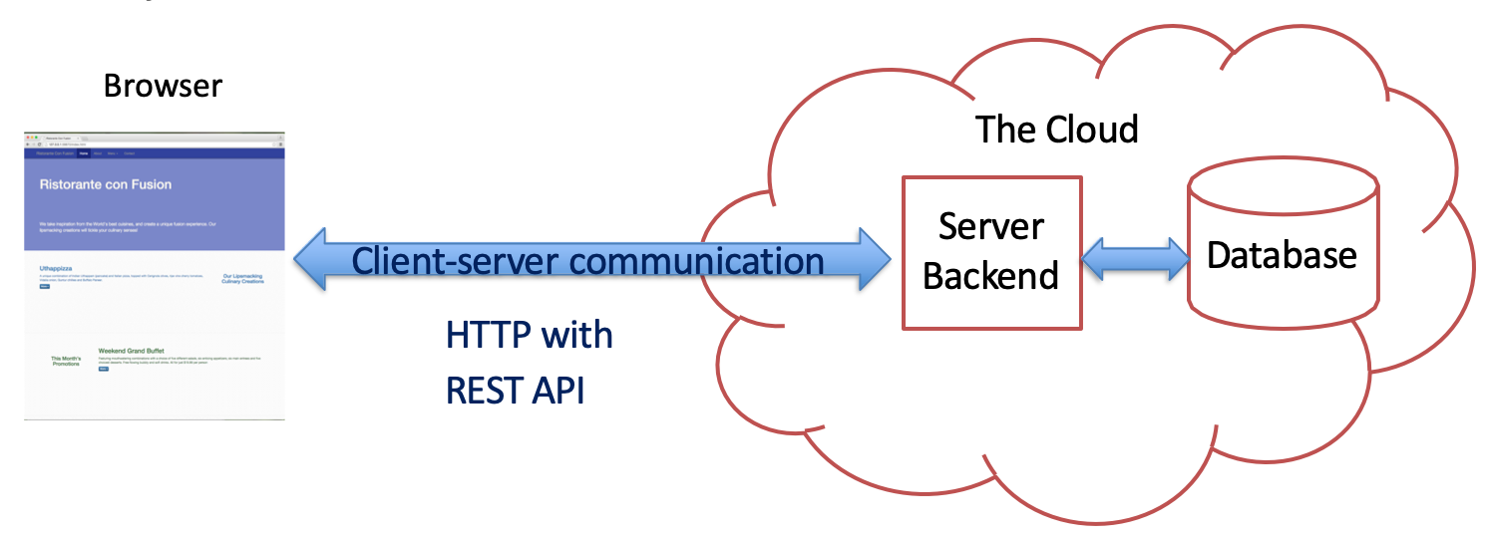
Client and Server
Web applications are not stand-alone
Many of them have a “Cloud” backend

Slide 4
Introduction to Client-Server Architecture
What is Client-Server Architecture?
A model where the client (user interface) and server (backend) communicate to deliver services.
Client: Requests services or data (e.g., a web browser or ReactJS app).
Server: Processes requests, stores data, and sends responses (e.g., Node.js, Django, .NET).
Key Features:
Separation of concerns: Client handles UI, Server manages logic and data.
Scalability: Servers can handle multiple clients.
Example: A ReactJS app (client) fetching data from an API (server).

Slide 5
Architecture of ReactJS Applications
What Architecture Do ReactJS Apps Use?
ReactJS applications typically follow the Client-Server Architecture.
Client: ReactJS frontend, running in the browser, built with components, state, and hooks.
Server: Backend services (e.g., REST API, GraphQL) handling data, authentication, and business logic.
Why Client-Server?
ReactJS excels at building dynamic, interactive UIs (client-side).
Servers provide data and processing power, enabling scalability and security.
Alternative Architectures:
Client-Side Rendering (CSR): the browser renders the application's UI by executing JavaScript. (Example: A ReactJS single-page application (SPA) like a dashboard fetching data via a REST API.)
Server-Side Rendering (SSR): React renders on the server for faster initial load (e.g., Next.js).
Static Site Generation (SSG): Pre-rendered pages for performance (e.g., Gatsby).

Slide 6
What is a Client in ReactJS?
Client Definition:
The client is the frontend of the application, running in the user’s browser.
In ReactJS, the client is a single-page application (SPA) built with components, managed by libraries like React Router for navigation.
Key Responsibilities:
Render UI dynamically using JSX and React components.
Manage local state (e.g., using useState, useReducer).
Send requests to the server (e.g., via fetch or axios).
Example: A ReactJS app displaying a list of products fetched from a server.

Slide 7
Advantages of CSR in ReactJS
Fast Navigation: After initial load, page transitions are quick since rendering happens in the browser.
Rich Interactivity: Ideal for dynamic SPAs (e.g., social media feeds, dashboards).
Reduced Server Load: Servers focus on delivering data, not rendering HTML.
Developer Experience: React’s component-based structure simplifies building complex UIs.
Example: A ReactJS e-commerce app where users filter products without page reloads.

Slide 8
What is a Server in ReactJS Applications?
Server Definition:
The server is the backend that processes client requests, manages data, and responds with results.
Built with technologies like Node.js, Express, Django, .NET or Spring Boot.
Key Responsibilities:
Handle API requests (e.g., GET /products, POST /orders).
Manage databases (e.g., MongoDB, PostgreSQL, SQL Server).
Ensure security (e.g., authentication, authorization).
Example: A Node.js server with a REST API endpoint /api/products returning JSON data.

Slide 9
Client-Server Communication Methods
Network operations cause unexpected delays
You need to write applications recognizing the asynchronous nature of communication
Data is not instantaneously available
Primary Method: HTTP/HTTPS Requests
ReactJS clients use HTTP methods (GET, POST, PUT, DELETE) to communicate with servers.
Libraries like axios or fetch are commonly used.
Advanced Method: WebSockets
For real-time applications (e.g., chat apps), WebSockets enable two-way communication.

Slide 10
Hypertext Transfer Protocol (HTTP)
A client-server communications protocol
Allows retrieving inter-linked text documents (hypertext)
World Wide Web.
HTTP Verbs
HEAD
GET
POST
PUT
DELETE
TRACE
OPTIONS
CONNECT

Slide 11
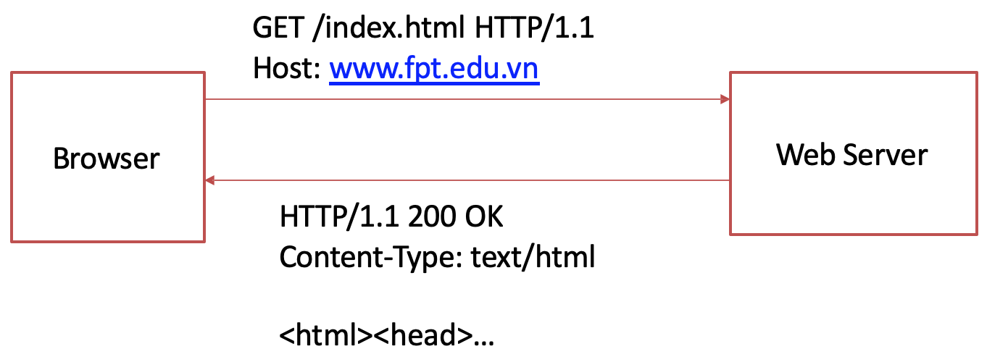
Hypertext Transfer Protocol (HTTP)

Slide 12
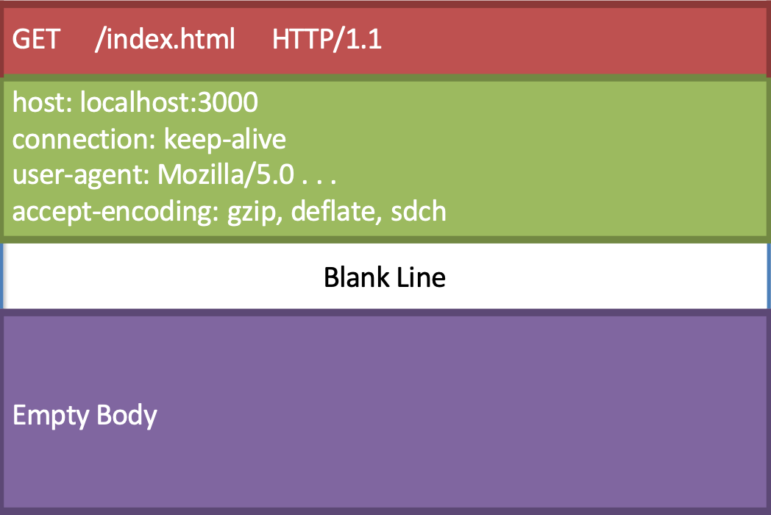
HTTP Request Message

Slide 13
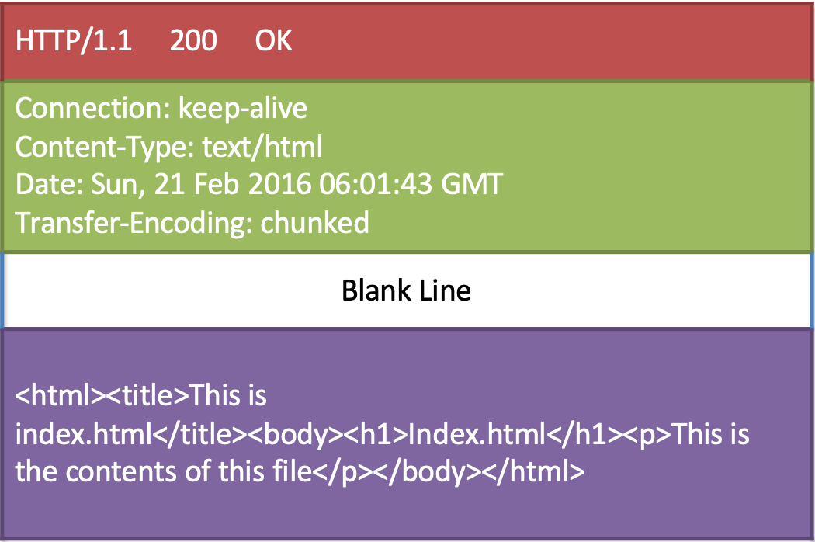
HTTP Response Message

Slide 14
HTTP Response Codes
Code | Meaning
200 | OK
201 | Created
301 | Moved Permanently
304 | Not Modified
400 | Bad Request
401 | Unauthorized
403 | Forbidden
404 | Not Found
422 | Unprocessable Entry
500 | Internal Server Error
505 | HTTP Version Not Supported

Slide 15
HTTP Response - Message Formats
Common Format: JSON (JavaScript Object Notation)
lightweight, human-readable, and widely supported.
Alternative Format: GraphQL
Clients request specific data structures, reducing over/under-fetching.
Other Formats:
XML (less common in modern React apps).
FormData for file uploads.

Slide 16
Javascript Object Notation (JSON)
http://www.json.org
Lightweight data interchange format
Language independent *
Self-describing and easy to understand

Slide 17
Javascript Object Notation (JSON)
Example
[
{
"id": “1”,
"name": “Damari",
"image": "images/damari.jpg", “category": “Dendrobium",
“rating": 4.5,
},
]
Data structured as:
A collection of name/value pairs
Ordered list of values

Slide 18
Web Services
A system designed to support interoperability of systems connected over a network
Service oriented architecture (SOA)
A standardized way of integrating web-based applications using open standards operating over the Internet
Two common approaches used in practice:
SOAP (Simple Object Access Protocol) based services
Uses WSDL (Web Services Description Language)
XML based
REST (Representational State Transfer)
Use Web standards
Exchange of data using either XML or JSON
Simpler compared to SOAP, WSDL etc.

Slide 19
Representational State Transfer (REST)
A style of software architecture for distributed hypermedia systems such as the World Wide Web.
Introduced in the doctoral dissertation of Roy Fielding
One of the principal authors of the HTTP specification.
A collection of network architecture principles which outline how resources are defined and addressed

Slide 20
Representational State Transfer (REST)
Four basic design principles:
Use HTTP methods explicitly
Be stateless
Expose directory structure-like URIs
Transfer using XML, JavaScript Object Notation (JSON), or both

Slide 21
REST and HTTP
The motivation for REST was to capture the characteristics of the Web that made the Web successful
URI (Uniform Resource Indicator) Addressable resources
HTTP Protocol
Make a Request – Receive Response – Display Response
Exploits the use of the HTTP protocol beyond HTTP POST and HTTP GET
HTTP PUT, HTTP DELETE
Preserve Idempotence

Slide 22
Resources
The key abstraction of information in REST is a resource.
A resource is a conceptual mapping to a set of entities
Any information that can be named can be a resource: a document or image, a temporal service (e.g. "today's weather in Hong Kong"), a collection of other resources, a non-virtual object (e.g. a person), and so on
Represented with a global identifier (URI in HTTP)
http://doamin/api/v1/orchids/3

Slide 23
Naming Resources
REST uses URI to identify resources
http://domain/api/v1/orchids/
http://domain/api/v1/orchids/3
http://domain/api/v1/categories/
http://domain/api/v1/categories/3
As you traverse the path from more generic to more specific, you are navigating the data
Directory structure to identify resources

Slide 24
Verbs
Represent the actions to be performed on resources
Corresponding to the CRUD operations
HTTP GET → READ
HTTP POST → CREATE
HTTP PUT → UPDATE
HTTP DELETE → DELETE

Slide 25
HTTP GET
Used by clients to request for information
Issuing a GET request transfers the data from the server to the client in some representation (XML, JSON)
GET http://domain/api/v1/orchids/
Retrieve all orchids
GET http://domain/api/v1/orchids/3
Retrieve information about the specific orchid

Slide 26
HTTP PUT, HTTP POST, HTTP DELETE
HTTP POST creates a resource
POST http://domain/api/v1/feedback/
Content: {first name, last name, email, comment etc.}
Creates a new feedback with given properties
HTTP PUT updates a resource
PUT http://domain/api/v1/orchids/3
Content: {name, image, description, category, …}
Updates the information about the orchid
HTTP DELETE removes the resource identified by the URI
DELETE http://domain/api/v1/orchids/3
Delete the specified orchid

Slide 27
Representations
How data is represented or returned to the client for presentation
Two main formats:
JavaScript Object Notation (JSON)
XML
It is common to have multiple representations of the same data
Client can request the data in a specific format if supported

Slide 28
Summary
Concepts were introduced:
Introduction to Client-Server Architecture
Architecture of ReactJS Applications
Client-Server Communication Methods
Message Formats in Client-Server Communication
Set up a simple server that makes data available for clients
Access the data from the server using a browser

